Slide 1

What is ?
Free service offered by Google
The most widely used website statistics service*
Provides statistics and reports about visitors and transactions on a website
At-a-glance dashboard view as well as detailed reports
* Source: http://w3techs.com/technologies/overview/traffic_analysis/all

Slide 2
How does Google Analytics work?
Establish a User ID and password at google.com/analytics
Google then provides a “page tag” or Google Analytics Tracking Code that needs to be added to each page of a website
This tag collects data and sends it back to the Google servers for processing

Slide 3
What does it do?
Google Analytics is a powerful tool that analyzes:
Website traffic
  Where visitors came from
  How they are navigating through your site
    How they navigated from page to page
    Which pages they stayed on longest or left from the most frequently (“bounce rate”)
Conversions
    downloads
    page views
    registrations
E-commerce
  Volume of transactions
  Dollar value of transaction
  Success of transactions
    % complete and % dropped out of sales funnel
AdWords Performance

Slide 4
How can it help a website?
Helps with development and optimization of landing pages
  How relevant were they to the visitor?
Identifies navigation challenges that may prevent visitors from getting to your goal
Optimization of AdWords performance
  keywords
  timing
  geographic differences

Slide 5
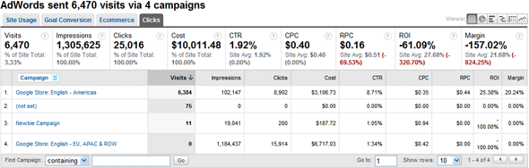
AdWords Report

Slide 6
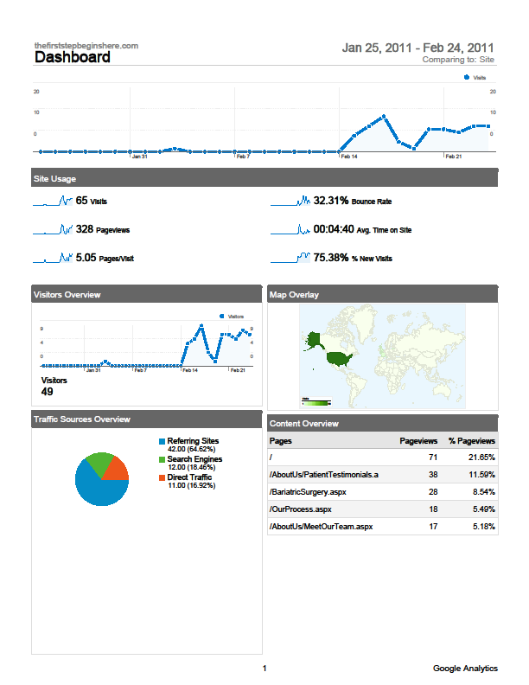
Dashboard Report

Slide 7
Industry Benchmarking
To gain access to this feature users must opt-in to “share the account data in an anonymous, aggregated format”
Once enabled, Google Analytics assesses the profiles in your account, categorizes them by vertical market and number of visits
and aggregates the data for inclusion in the benchmarking project

Slide 8
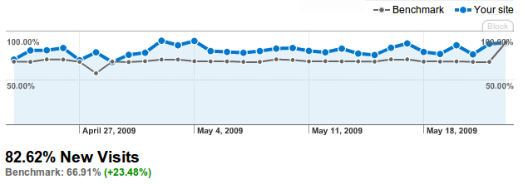
Website’s new visits benchmarked against similar industry

Slide 9
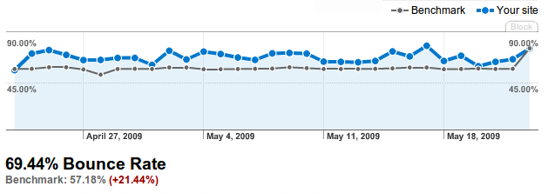
Website’s new bounce rate benchmarked against similar industry

Slide 10
Keywords Overview
There are two types of traffic that come to a site through search engines; organic (unpaid) and paid. By reviewing the keywords users are entering into search engines, web masters are able to get an overview of the organic traffic that is coming through their site.
if a keyword has a high ‘average time on site’ associated with it, the visit was probably of more value to the user than a visit resulting from a keyword with a low average time on site.

