Slide 1





COACHING, COUNSELLING AND VOCATIONAL GUIDANCE
Group Meeting 3 – Monday 11 November 2019
Katerina Anagnostopoulos
Career guidance and development adviser – Trainer
Registered Psychologist, Psychotherapist

Slide 2

The state of play
Attuning to the present moment
Development in your doctoral studies agenda
What has happened since the last time we met?

Slide 3
Proposed dates for the next meeting
Morning career guidance sessions (3)
Group Meeting 4 in the afternoon
Monday, 27 January 2020
Monday, 10 February 2020

Slide 4
Session A – Career Planning
How to find and handle information about career paths and job opportunities
Mapping sectors, job positions, research the job market optimizing existing resources and tools
Reflecting on two short career narratives

Slide 5
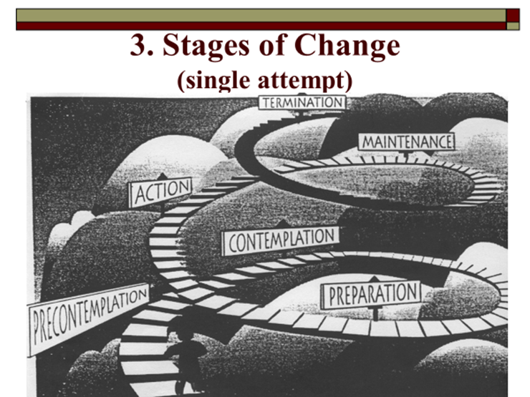
Different stages of development
And change process
Precontemplation
Contemplation
Preparation for action
Action
Maintenance Completion
Starting a new cycle…
A recursive process

Slide 6
Career building and planning
Identify skills correspondence with specific jobs, or skills gaps. These may be technical or transversal.
Treasure your works (experience, knowledge, skills, publications).
Create the preconditions for Happenstance to unfold. This is what planned happenstance means.

Slide 7
Career building and planning
Optimize time and existing resources
Active jobs mapping and search tools

Slide 8
Preferences and priorities expressed in Jul19 and Sep19 Meetings
Individual career guidance sessions for c.v. review and career planning
Postdoc options and opportunities
CV writing and customizing/adapting
Linkedin, Researchgate, Video, Portfolio
Practice presentation skills
Self-presentation, defining a versatile professional identity
Networking and treasuring contacts (e.g. secondment, attending conferences)
Skills audit

Slide 9

C.V. and research/professional profiles in online platforms, directories, etc.
Can be at the same time:
Corresponding to truth
tailored to the profile and professional identity you want to convey
while matching the requirements of the positions you are interested in.

Slide 10
C.V. and profile on online platforms, directories
Lay down the preconditions for a succesfull matching
Explore the job offers and job market opportunities (both academia and non-academia)
Specific websites for post-doc research or other positions

Slide 11
Self-awareness
Have a clear idea of your criteria
Research field
Geographical
Objective
Kind of work

Slide 12
Career building and planning
Go beyond the job seeking attitude and make change come true
Self-entrepreneurship for research careers
Source: http://www.thehindu.com/todays-paper/tp-national/tp-karnataka/Human-beings-were-not-meant-to-be-job-seekers-Muhammad-Yunus/article17207016.ece#
"Human beings were never intended to be job seekers, but to use their creativity to find solutions to problems"
Muhammad Yunus

Slide 13
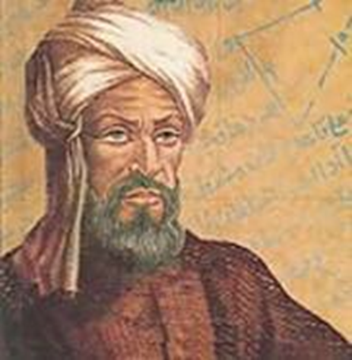
C.V. and profile on online platforms, directories
Online job matching platforms based on algorithms
The word Algorismus which derives from the Latinization of Al-Khwarizmi's name, turned into the name of method used for computations, and survives in the modern term "algorithm"
Muḥammad ibn Mūsā al-Khwārizmī
Persian mathematician, astronomer
Are you willing to let only algorithms rule your career building process? So, what are you to do? You can do a lot.

Slide 14
ResearchGate
Advertisement in Researchgate
Are you hiring researchers and scientists?
Post a job on ResearchGate to find the best candidates from our network of 15milion researchers

Slide 15
ResearchGate
Summary of Researchgate recruitment service
Search member by.
Keyword
Publication history
Institution
Algorithms display jobs to relevant researchers
We'll display your job to the right experts by matching your job to their
profiles
publication histories
skills and expertise.
When you search our members by area of expertise, institution, location, and more, we use their profiles and unique publishing histories to match the right researchers to your specific requirements.
Source: ResearchGate

Slide 16

Topics and activities
Writing, reviewing and tailoring the C.V.;
Presentation, self-promotion and visibility strategies.
Personal and professional identity (personal branding). Building and maintaining a durable professional integrity and reputation: values, interfacing with social media.
Exploring and mapping sectors and organisations of interest; evaluating opportunities.
Methods and search strategies; active job search tools; identifying, Handling change; effectively adapting to different work environments [secondment].
Self care, stress management and work-life balance.
Motivation, self-efficacy, will and self-determination.

Slide 17
Career goals and trajectories
Academic vs. Non-academic
Research vs. non-research career
University vs. Non-university research performing organisation
Industry or other for-profit sector
Public or private non-profit research organisation
Other public/private institutions, Cultural entities

Slide 18
Career goals
Pave the way for the transition to a Postdoc career
C.V., visibility online, research profile definition, networking, publishing
Relationship building and networking are ongoing processes

Slide 19
From life and career roles to possible future selves
Career encompass the total constellation of life roles that we play.
In order to manage your career effectively it is useful to integrate the roles of life
Careers as manifestations of our attempts at making sense out of our life experiences
Internal cognitive processes + External factors, society, culture, relationships that shape a person’s career development
Notes:
19

Slide 20
Links to relevant web sites
References/Links
https://www.researchgate.net/publication/322508504_Visualizing_detailed_postdoctoral_employment_trends_using_a_new_career_outcome_taxonomy

Slide 21
Online tools and resources
Science and Technology Jobs
https://www.elsevier.com/connect/how-to-find-your-dream-research-job-without-swimming-through-a-sea-of-listings
Science and Technology Jobs
https://www.mendeley.com/careers/

Slide 22
Science and Technology Jobs
https://www.mendeley.com/careers/

Slide 23
Practice WILL
Mapping and analysing recruitment web sites
Lifescience Recruitment
https://lifescience.ie/
https://jobs.sciencecareers.org/

Slide 24
Tailoring strategies
that work for you
Online resources
Explore information and filter
Practice and exercise
Ask a peer to peer feedback from trusted colleagues

Slide 25
Planned happenstance - I
Constructing unexpected career opportunities
Identifying,/creating/benefitting of chances and opportunities
Acknowledging chance in your career and work practices
Reviewing your role(s) and self-identities
Uncertainty bears also merits and potentialities
Accept and appreciate not knowing (R. Feynman, Nobel Prize in Physics, 1965)
Adapted from: Mitchell, Levine, Krumboltz; 1999; Gysbers, Heppner, Johnston, 2003.

Slide 26
Oral presentation skills
Session B: 16.00 – 17.30
Public speaking implies self – exposure
To practice oral presentation skills helps enhancing mastery in handling interviewing processes, facing exams, coordinating meetings, etc.

Slide 27
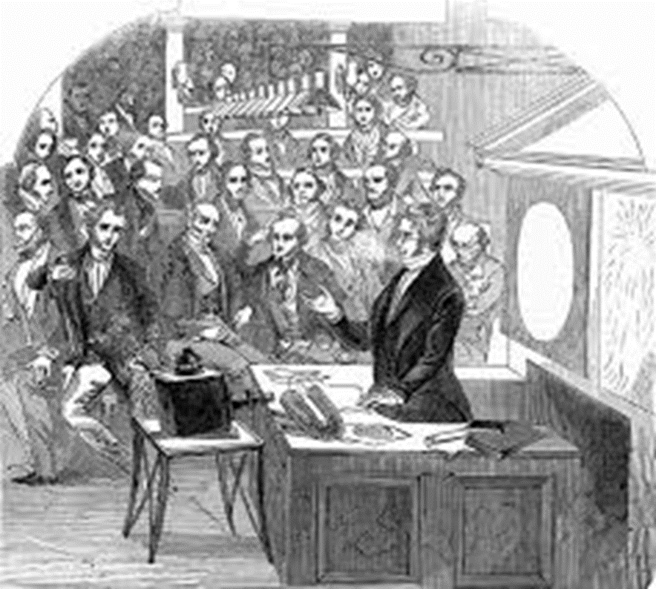
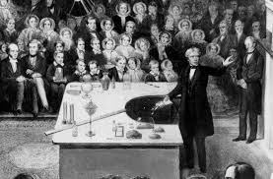
Giving effective oral presentations
Michael Faraday’s lectures and conferences

Slide 28
Transversal and transferable skills
Communication skills
Communication/Presentation
Communication/Dialogue with non technical audiences*
Teaching skills
Use of science* in policy making
(OECD)

Slide 29
Oral presentation skills
Experiential exercise and practice serve the purpose of
Building self-confidence
Desensitize from performance anxiety
Having feedback from oneself and others
Enhancing awareness
Optimizing modes of presenting facts, ideas, yourself…
Identify elements to address and ameliorate

Slide 30
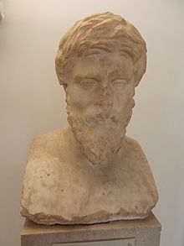
Develop listening skills
Plutarch attributed qual weight to the practice of speaking abilities
and to the acquisition of the habit of listening
“listen cheerfully and affably as though he were a guest at some dinner or ceremonial banquet, commending the speaker's ability in those parts wherein he achieves a success, and favourably accepting the goodwill, if nothing else, of the speaker who propounds his opinions and tries to persuade others by the reasons which have persuaded himself”
Περὶ τοῦ ἀκούειν τῶν φιλοσόφων, "On Listening to the Lectures of Philosophers,“ Plutarch

Slide 31

Giving and receiving feedback
Listening attentively and actively
Offering feedback without judging
Multiple perspective taking
Taking the perspective of the speaker/the audience
Self-feedback
Strenghts and aspects to enhance

Slide 32
Arrivederci!
Thank you for your commitment and participation
Next meeting in Year 2020

